Slide 1
The Effects of Study Abroad on
Student Identity, Faith,
Global Citizenship, and Emotional Awareness
NetVUE Conference - Indianapolis
March 14, 2013
Pepperdine University
Don Thompson
Cindy Miller-Perrin

Slide 2
Students experience significant changes in their perception of life purpose or vocational calling during their sophomore year, when they frequently go through identity crises with their faith and sense of life purpose. We present research findings describing ways that universities can provide students with spiritual mentoring during this pivotal sophomore year.
Our Presentation
Impact of Study Abroad at Pepperdine
Pepperdine’s Voyage Project – Longitudinal Study - The Lilly Endowment’s PTEV
The Sophomore Year Overseas

Slide 3
International Programs at
Pepperdine University
Provide students a life changing international experience designed for intellectual, social, personal and spiritual transformation
Buenos Aires, Costa Rica, Fiji, Florence, Heidelberg, Honduras, Lausanne, London, Madrid, Shanghai
55% of sophomores participate
Student Experiences
  Academic – Full Semester/Year Coursework
  Living Community – House and Home-stay
  Spiritual – Student Led Bible Studies, House Church
  Service Projects
  Cultural
    Extensive Local Travel Opportunities
    Group Field trips – Spain, Greece, France, Austria, Brazil, Uruguay
  Mentoring – Visiting Faculty, Staff, Peers

Slide 4

Heidelberg

Slide 5
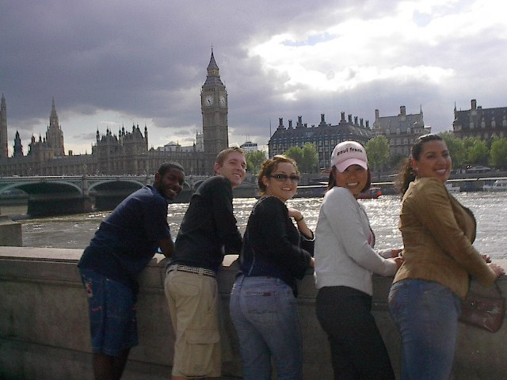
Travel
Students travel each weekend
Program-wide field trip each term

Slide 6

Living & Learning Community:
Moore Haus

Slide 7
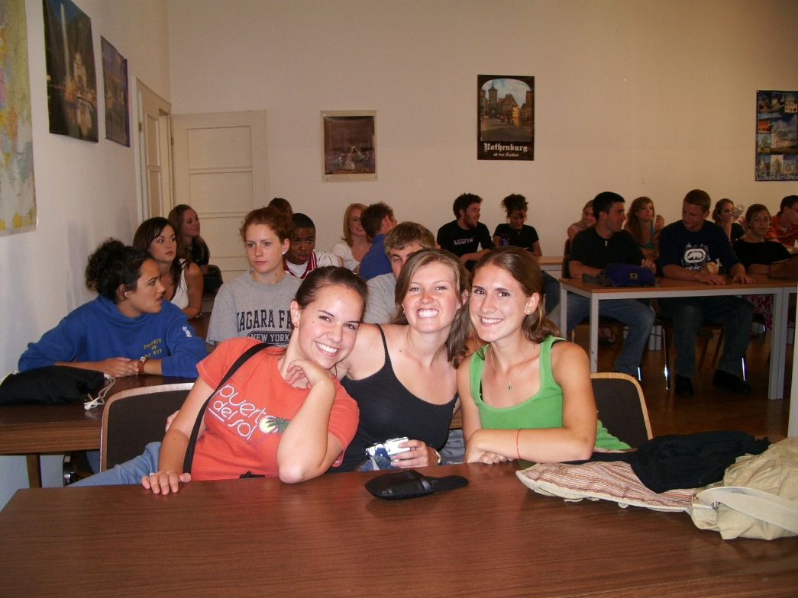
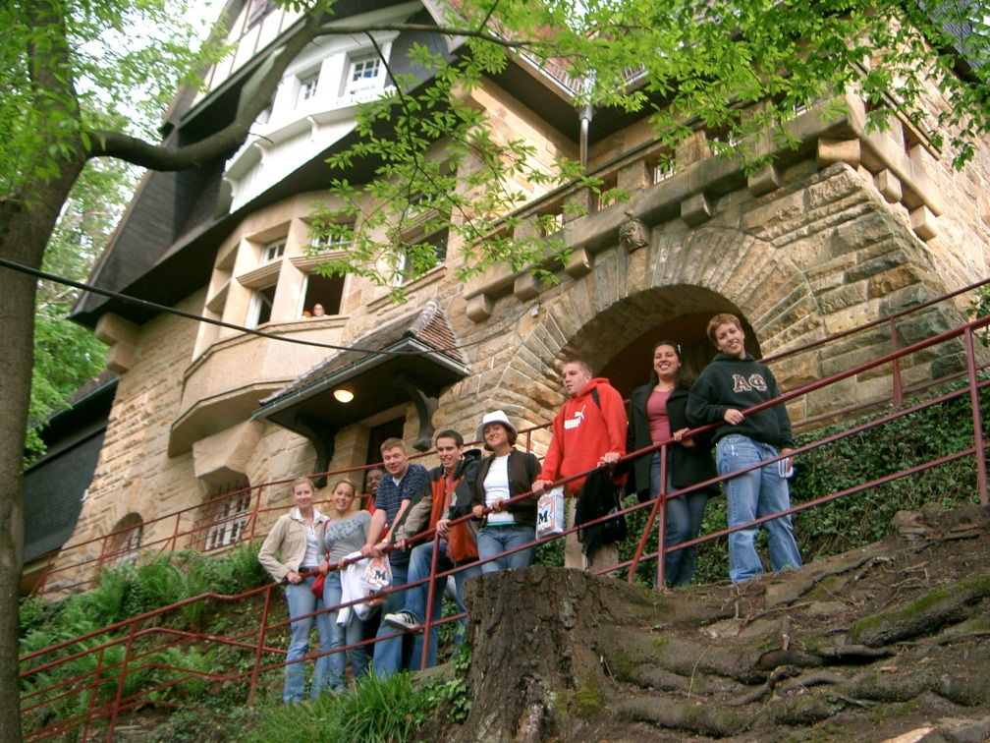
Home to 55 Sophomores & the Visiting Faculty Family
Library, computer lab, administrative
offices, dorm rooms, and student center

Slide 8
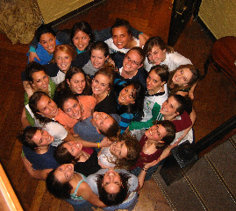
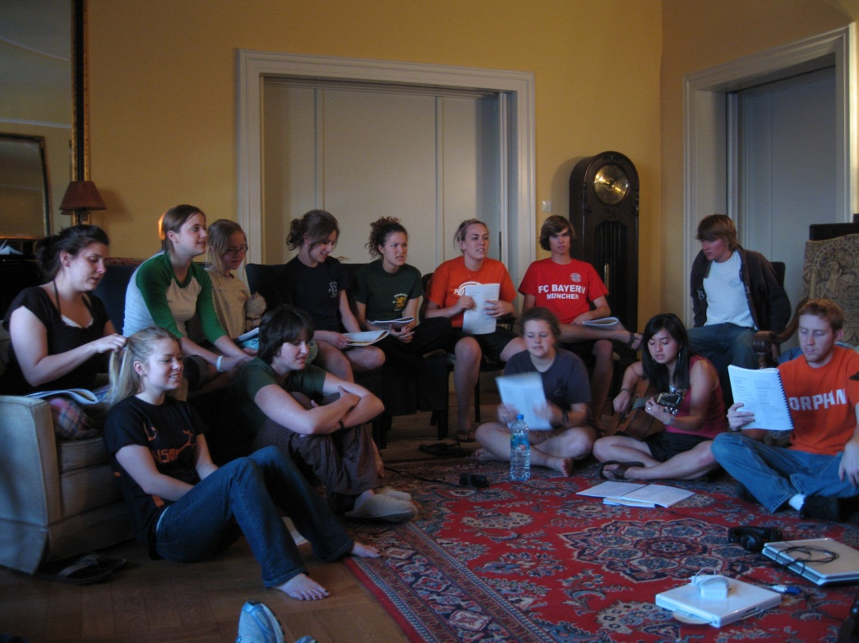
Spiritual Community
Weekly Bible studies and House Church

Slide 9
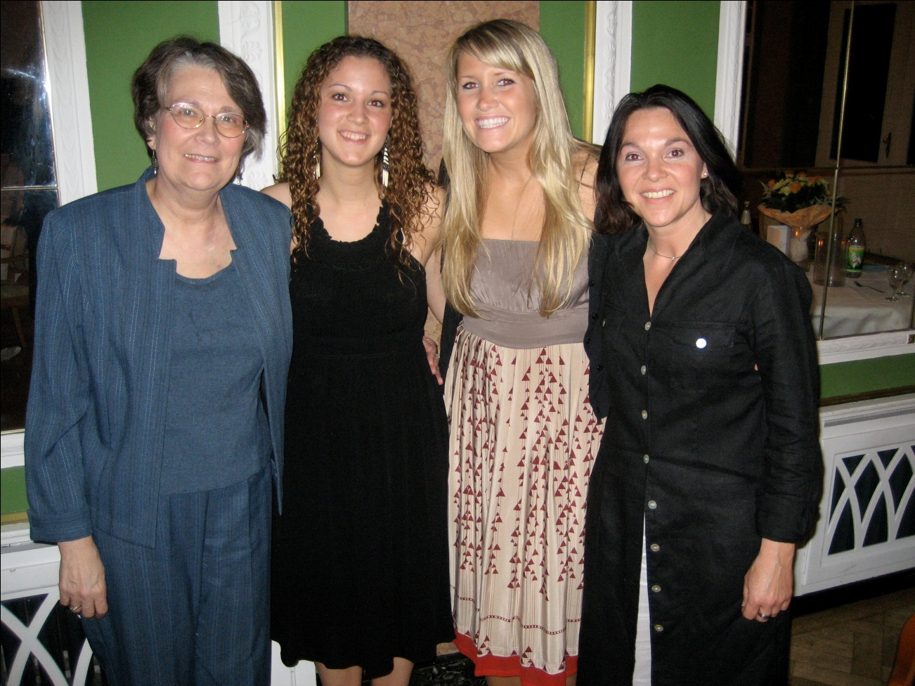
Mentoring Community
The mentor-protégé relationship is
based on trust and love

Slide 10
The Sophomore Experience:
College as Rite of Passage
Impact of Study Abroad at Pepperdine
Rite of Passage
  Departure, Initiation, Return
Research Hypothesis & Measures
  Student life purpose (vocational calling) development is formed by the intersection of faith development, identity development, and spiritual barriers
  Global Awareness: Empathy and Action
  Emotional Awareness: Appraisal & Expression, Regulation, Utilization
  Strength of Religious Faith Measure
Longitudinal Design
  Fall 2010 – Pre – Fall of First Year
  Spring 2012 – Mid – Spring of Sophomore Year
  Fall 2012 – Post – Fall of Junior Year

Slide 11
Sampling
Fall 2010 (Pre)
  880 students apply to study abroad in 2011-12
Spring 2012 (Mid)
  210 IP students re-survey
  116 NOIP students re-survey
Fall 2012 (Post)
  90 IP students re-survey
  32 NOIP students re-survey

Slide 12
Repeated Measures ANOVA Statistical Significance: p < 0.5
Time*
Time & Group Interaction **
Both ***

Slide 13
Ego Identity Status Measure
13
  Diffusion: no exploration or commitment (-,-)
    “I haven’t really considered politics. It just doesn’t excite me much.”
  Foreclosure: no exploration, but commitment (-,+)
    “My parents decided a long time ago what I should go into for employment and I’m following through with their plans.”
  Moratorium: exploration without commitment (+,-)
    “Religion is confusing to me right now. I keep changing my views on what is right and wrong for me.”
  Achievement: exploration and commitment (+,+)
    “It took me a while to figure it out, but now I really know what I want for a career.”

Slide 14
Diffusion ***
14
Notes:
14

Slide 15
Foreclosure **
15
Notes:
15

Slide 16
Moratorium **
16
Notes:
16

Slide 17
Achievement
(Pre-Mid **)
17
Notes:
17

Slide 18
Schutte Self-Report Inventory
Emotional Awareness Measure
Appraisal and Expression
  Other people find it easy to confide in me
  Some of the major events of my life have led me to re-evaluate what is important and not important
  I am aware of my emotions as I experience them
Regulation
  I seek out activities that make me happy
  When I am in a positive mood, solving problems is easy for me
  I have control over my emotions
Utilization
  I am aware of the non-verbal messages other people send
  When I feel a change in emotions, I tend to come up with new ideas
  When I am faced with a challenge, I give up because I believe I will fail (Reverse Coded)
18
Notes:
18

Slide 19
Appraisal & Expression *
19
Notes:
19

Slide 20
Regulation *
20
Notes:
20

Slide 21
Utilization *
21
Notes:
21

Slide 22
Global Awareness Measures
Empathy
  I have a duty to improve the world in which I live
  I enjoy spending time with people from other racial/ethnic/cultural groups
  I often think about how my personal decisions affect the welfare of others
  I can describe some ways that people in the country of my international program have been affected by the foreign policy of the country in which I was raised
Action
  I contribute money to international relief efforts
  I am involved with organizations that provide help for people in other countries
  I keep myself informed about international news and public issues
  I am one to speak up about racial injustice
22
Notes:
22

Slide 23
Empathy ***
23
Notes:
23

Slide 24
Action *
(Pre-Mid ***)
24
Notes:
24

Slide 25
Santa Clara Strength of
Religious Faith Measure
My religious faith is extremely important to me
I pray daily
I look to my faith as a source of inspiration
I look to my faith as providing meaning and purpose in my life
I consider myself active in my faith or church
My faith is an important part of who I am as a person
My relationship with God is extremely important to me
I enjoy being around others who share my faith
I look to my faith as a source of comfort
My faith impacts many of my decisions
25
Notes:
25

Slide 26
Faith Strength*
26
Notes:
26

Slide 27
What happens LONG term?
27

Slide 28
Pepperdine’s Voyage Project
Lilly Endowment’s PTEV
Longitudinal Study
Vocation Grant Activity
  Planning Grant 2001-2002
  Major Grant 2002-2006
  Sustaining Grant 2006-2008
  Ongoing Activities – 2008-Present
Significant Grant Initiatives
  Student Vocational Calling Longitudinal Study
  Curricular and Co-curricular Components
  Student Leadership and Ministry Initiatives
  Faculty Development
    Significant Institutional Learning: Research Outcomes
  Students’ Personal Change: Sophomore Year
  Faith, Learning & Vocation Workshops for Faculty
28

Slide 29
Longitudinal Design
  Spring Survey
    First-Year, Sophomore, Junior, Senior
    1200 Subjects Participate Annually
Survey Measures
  Ego Identity
  College Student Behavior
  Emotional Awareness
  Mentor/Protégé Reflection
  Several Faith Measures
  Vocational Discernment & Action
  Barriers to Life Purpose
  Perceived Well Being

Slide 30
Faith Attitude & Behavior Survey
30
Subscales | Sample Items
Strength of Beliefs (α = 0.73) | I view myself as a religious person I have doubts about whether my religious beliefs are true
Importance of Faith (α = 0.89) | Religion is not a very important part of my life right now My faith is not very important to me
Life Application of Faith (α = 0.92) | I depend on my faith in God for decision-making and direction I try hard to carry my religious beliefs into all other dealings in my life
Faith Behavior (alpha = .88) | How often do you attend religious services How often have you read a devotional, religious, or spiritual book in the last year

Slide 31
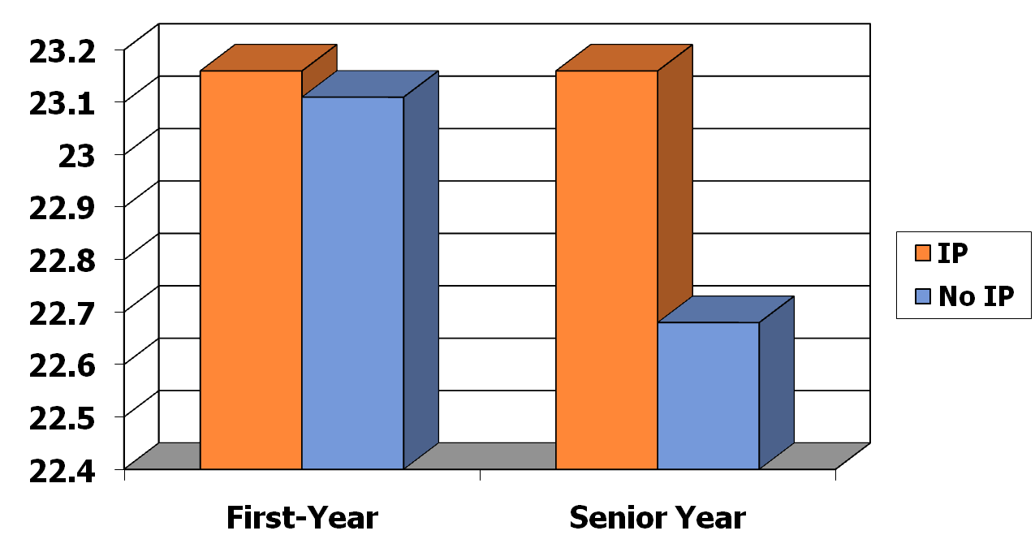
Strength of Belief
First-Year and Senior Time Periods ***
31

Slide 32
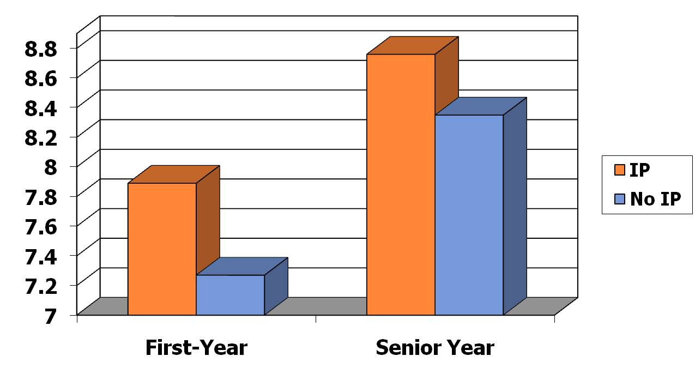
Faith Importance
First-Year and Senior Time Periods ***
32

Slide 33
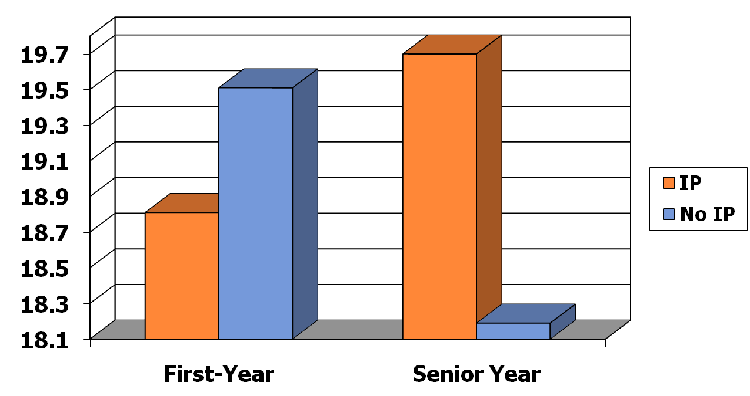
Faith Application
First-Year and Senior Time Periods ***
33

Slide 34
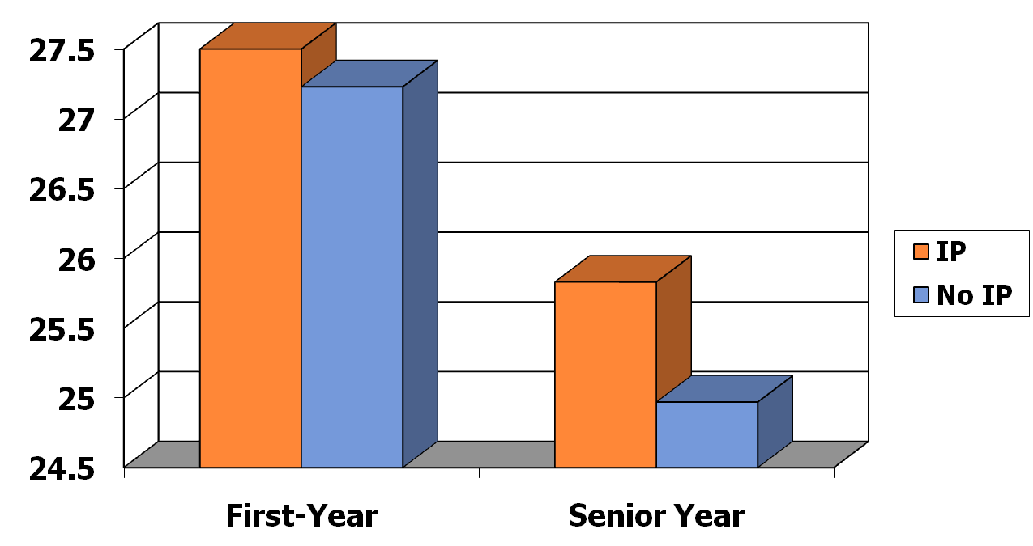
Faith Behavior
First-Year and Senior Time Periods ***
34

Slide 35
Vocational Discernment and Action
35
Subscales | Sample Items
Discernment and Purpose (α = .76) | I have a good sense for my life purpose I know of the many ways that I can use my gifts and talents within the context of my professional career I am unsure about what God is specifically calling me to do
Service to Others (α = .68) | I am motivated to choose a career that will enable me to provide some type of service to others I feel a deep sense of responsibility for reducing pain and suffering in the world

Slide 36
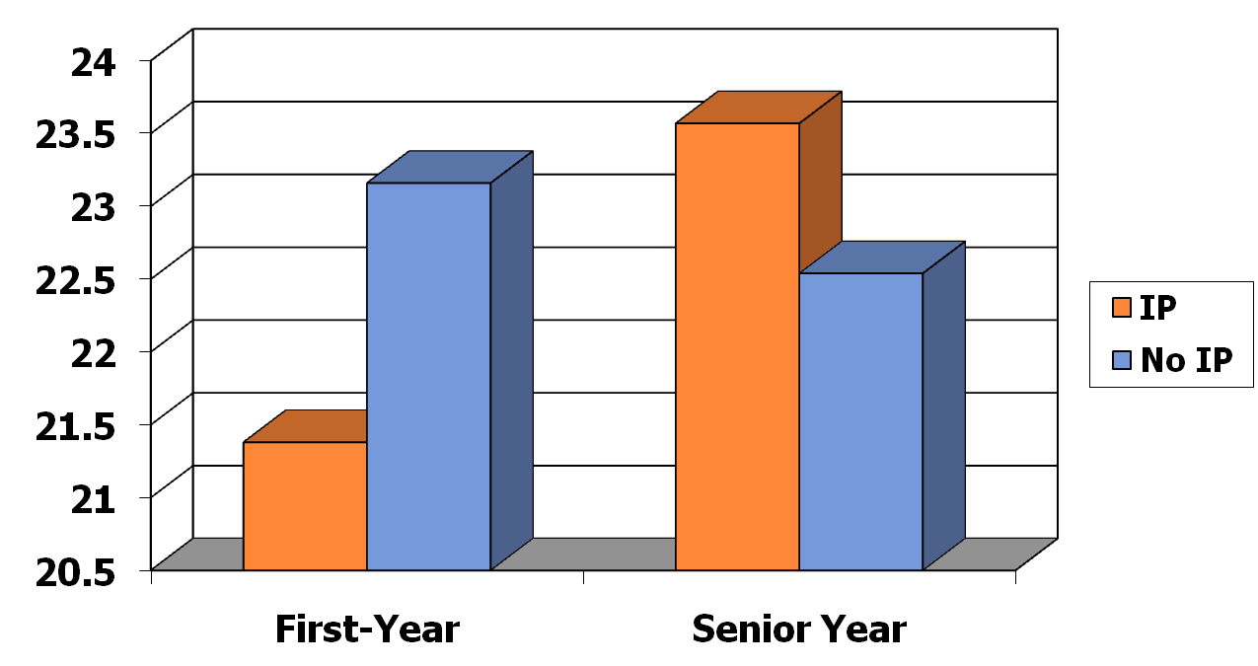
Discernment
First-Year and Senior Time Periods ***
36

Slide 37
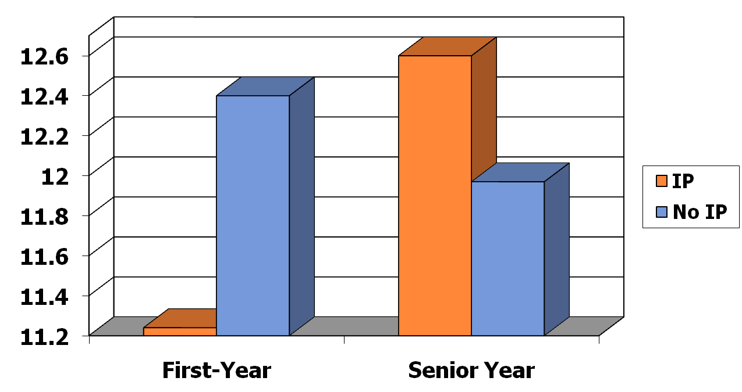
Service
First-Year and Senior Time Periods ***
37

Slide 38
Factors Contributing to Spiritual Growth in International Programs
38
Travel
  Departure & Initiation
Mentoring
  Initiation
Community
  Initiation & Return

Slide 39
Travel
What has been the most spiritually challenging part of your International Program experience?
39
“This has been the hardest but also the best year of my life. Living overseas forced me to either embrace or reject what I have believed all my life. It removed my safety nets.”
“I have grown through having to lean on God in almost every situation: from traveling to school to just living in a different culture, speaking another language.”
“My month long trip to Africa between semesters challenged my sense of self.”
“Traveling alone over Christmas Vacation showed me how to depend on the grace of God for support.”
“A person I met in Greece helped me realize my selfishness, making me want to be more generous.”

Slide 40
The Mentor-Protégé Relationship:
The Mentor
    Understanding my own vocational journey
    Keys to self-discovery
      Vocational Autobiography Reflection
Notes:
(7 minutes)
Intro: Will be sharing from the perspective of a new faculty member. 2nd year assistant professor of psychology – got to participate in the New Faculty orientation last summer at the end of my first year teaching.
Bullet 1:
To provide students with guidance during their vocational journeys, it is critical that faculty members are prepared personally and pedagogically to help their students. My belief is that this preparedness starts with having insight into our own vocational journeys because this will allow us to share with students from our own experience but also to more readily recognize in students what they are experiencing and how we can provide guidance in their process.
Bullet 2:
As a new faculty member, my personal process of self-discovery was encouraged through a few key institutional activities – including the vocational autobiography reflection exercise and the new faculty retreat.
Vocational autobiography:
-During our first semester teaching, we were given the opportunity to write our vocational autobiography. We asking us to write down how we personally had experienced a sense of vocation or calling in our lives. In writing my story of vocation, I was able to realize several central themes in my own thoughts and experience on the topic. For example, one theme I discovered was that in my view, the concept of vocation, or calling, is much broader than that of profession or career. Therefore, the vocational autobiography that I wrote was more of a spiritual journey than a career journey. I believe that as Christians, God can call us to both general and specific things. But in my view, there does not seem to be a direct link between God’s call and being paid monetarily. In fact, it seemed to me that many forms of calling might cost money rather than exist in the form of a paid position (e.g., raising a kid, planting a church, providing for those in need). My basic understanding of vocation was that it encompasses God’s call for one’s life and actions which I see as an overarching reality that is broader than, but includes, work. Therefore I consider having a career in which I can live out this greater calling on a daily basis to be a luxury and a blessing. As a second example, in writing the reflection, I was able to discover that many of the stages of my career path revolved around a sense of being free to make choices based on my interests and desires rather than receiving external cues regarding the direction to take.
-New faculty retreat:
The New Faculty Retreat provided a setting in which to explore how we as faculty can live out our callings as Christian scholars and teachers. There are several aspects of this experience that stand out to me as highlights for my development:
We read various books prior to our time together and had opportunities to discuss themes related to Christian vocation in higher education. The readings were thought provoking and our discussions made many of the concepts come to life. In our discussions we were also able to explore our ideas of how to integrating faith and learning for our students.
As participants, we took turns sharing own vocational autobiographies with each other. I can’t tell you how enriching that was for building a sense of community. I experienced it as a privilege to hear the personal stories of my colleagues’ sense of vocation. This was very bonding for us as a group. But I also believe that hearing each person’s unique story helps ne to anticipate and recognize the many shapes and forms that calling may take among my students.
The retreat shaped my view of Pepperdine as a place of possibilities, opportunities, and growth on academic and spiritual levels – both for my students and for myself. It gave me a picture of the many formal and informal ways that I can use my gifts and talents within the Pepperdine community and work with others toward common goals. In many ways, I believe this parallels the excitement of being in college and thinking about all of the many possibilities for one’s future. Re-experiencing these feelings helped me to connect with some of the aspects of the student experience when making decision about how to invest themselves during college and in the years beyond.
Beyond the new knowledge and insights that I gained, one of the most meaningful aspect of the retreat was the message that I experienced coming out of the time, effort, resources and intentions that were required to make the retreat happen. The retreat was an extravagant week spent together overseas focusing on the important topic of faith and learning. The message that seemed to be communicated to me by the university administration was something to the effect of: “You matter to us, and we are investing in you with this retreat because we are entrusting you with something of utmost value – that is, aiding in the learning and development of our students.” In other words, I left with an overwhelming sense of having been invested in. I believe this modeled what I am to do with my students. Invest in them and communicate that they matter because they are entrusted with amazing responsibilities in this world. That unspoken message that I received from my university community through the new faculty retreat provides me with a genuine excitement about using the course of my career to be a good steward of the rich gifts of knowledge, insight, and community that were invested in me during the new faculty retreat. What I am entrusted with is the future of our students - and that is worth the extravagant investment that was made in me. I hope also that my actions will model to students how to invest their lives into matters of worth.

Slide 41
The Mentor-Protégé Relationship:
The Protégé
What do students need/want?
Helping students explore their callings
  Course-related methods
  Mentorship outside of the classroom
Notes:
The desired outcome for this project was to facilitating the vocational discernment of students, including aiding them in their development of faith, life purpose, identity, and service.
I believe that we should aim to helping students explore their calling both inside and outside of formal classes.
Course-related methods:
Models for classroom activities that help students explore their vocational roles will differ somewhat across disciplines. I focused in particular on how to incorporate opportunities for students to explore their calling within the context of PSYCHOLOGY courses. This, for the most part, did not involve creating new activities and assignments, but merely being mindful of the many ways that the course content relate to questions students are facing about who they are and how they can use their gifts and talents in the present and future. For example:
My class on Counseling Theories and Techniques is a survey course of the predominant theoretical orientations to therapy today. After studying each of the major approaches to counseling, I ask students to write a reflection paper on their own theoretical orientation. This gives them the opportunity to think about what it might be like to work as a professional therapist or counselor and how they would approach helping clients on the basis of what they believe about human problems and where relevant the activity was open for them to incorporate their spiritual understanding of people and the role of religion in counseling.
In the same class, the students get to practice role plays in which they take on the role of therapist. This again is an activity in which they can experiment possible roles for their future and get a sense of what types of activities would be meaningful to them and fit with their identity, faith, and life purpose.
Of course other classes are a bit more challenging to incorporate these types of reflective and experiential activities. Nevertheless, I think it is worth exploring how to incorporate questions about life purpose and vocation into such classes as well. For example, in my research methods class, we talk about how conducting research is a service to individuals, groups, and society, and that therefore it is extremely important to consider how and why we select certain topics for investigation and whether we are overlooking needed areas of research, for example among neglected populations. There seems to be opportunity among these conversations for students to experience a call into a certain line of investigation.
-My goal for course related methods is to find activities or assignments that call on students to consider their gifts and talents and to envision or practice with various roles and identities that they may take on in the future.
Mentorship:
Many significant mentorship opportunities occur outside of formal class activity. Students often express that they desire a relationship with their faculty members. It is perhaps in the context of a mentoring relationship that faculty members have the greatest opportunity to impact students. This mentorship can happen in various settings – as students come to office hours or talk after class. One thing that I have found helpful is to set aside lunch time one weekday over the semester and open it up for students to sign up to have lunch together. Mentorship can take place in many forms:
-In informal conversations with students, it can be helpful if faculty are willing to share aspects of their own vocational stories with students as appropriate opportunities arise. For example, I have been able to share examples with them from my personal experience, such as sharing with them the various methods of discernment that were helpful to me, being willing to tell them about my own sources of confusion, and telling them about experiences that increased clarity along my path. One aspect of my experience that I share with students to help take the weight off of crises they may be experiencing about making life decisions is that I for the most part didn’t attach a moral value to my selection of a major, graduate school, or profession. Initially, I had no idea what I wanted to do in the future, I just knew that I found psychology captivating and I couldn’t think of any other subject I would enjoy as much. For a long time my decision was purely based in personal interest and was not goal directed. Yet, this led me to what I now see as my ideal career. An underlying theme in my vocational journey has been a sense of freedom to choose. I believe that God is able to use people many different settings and places.
-When students seem to be struggling with questions about their calling in life it can be helpful to be a listening ear for them as they share about crises of faith or crises of identity or life purpose. It can be beneficial to normalize this process for them, and maybe even connect with with peers peers who are going through similar experiences.
-Finally, mentorship can also be strengthened by engaging in meaningful activities with students, such as participating in organized student ministries and service activities. I have found that involvement in these areas through church and our campus volunteer center have opened more opportunities to connect with students around themes related to life calling.

Slide 42
The Mentor-Protégé Relationship
Common pitfalls in student thinking about vocation
  Narrow views of vocation
  Vocation as static
  False dichotomies
Notes:
Finally, in the mentoring relationship, I think it is helpful for faculty members to be aware of the pitfalls that students may experience in their thinking about vocation and to be able to gently challenge some of these ideas. For example,
-Students may have a constrictingly narrow view of vocation e.g. (1) “job” rather than “life calling” or (2) a moral decision where there is only 1 right answer as opposed to a way of life that involves multiple fruitful options. In this case, it may be helpful to ask them whether they have considered other aspects of their identity or life passions or how they see these components fitting into their calling in life.
-Also, students might conceptualize vocation as a one-time decision rather than a dynamic process that evolves over a lifetime. Providing some casual education about this can help students to see calling as something that evolves over time. This may take the pressure off of decisions that are made during the college years and also help them to keep open eyes and ears for ways that they may be able to serve in different ways at different times.
-False dichotomies, such as the pressure to chose between being EITHER a Christian OR a Scholar. Either a minister OR a professional. Either a family person OR a career person. When students are speaking in extremes or dichotomies it can be helpful to simply raise the question whether they see multiple roles as mutually exclusive and if so, why. This may open the door for them to consider what it would look like to be a CHRISTIAN SCHOLAR or combine various other roles in a meaningful way.

Slide 43
Mentoring
Who has been most instrumental in helping you grow spiritually? Why?
43
“One of the other students in the program made me challenge myself and helped me grow spiritually.”
“The host family impacted me the most because we are in worship with them and they are the leaders that we look up to in the house.”
“When I felt weak, my faculty “mom” knew and was someone that would come up to me and ask what was wrong. She would help me understand and trust in God.”
“The host family made me feel at home and always made time to check on me and how I was doing.”
“The program assistant had a great impact on me spiritually this semester through her incredible yet humble display of faith. She is such an inspirational woman of God.”

Slide 44
Community
How has the community of the international program experience enhanced your spiritual growth?
44
“Our weekly, student led Bible studies & student run worship have had the greatest spiritual impact on me.”
“Women's small group and student-led worship were an AMAZING support system. The best community I've ever had. This is my home away from home.”
“The guys’ small group was a time where we could be open and honest.”
“I have grown more here in my spirituality than I did at home and all of that growth was due to other students.”
“Simply by living with and engaging with such incredible individuals, who have not only helped me through difficult times, but who have encouraged me to seek God more, I've experienced a growth in spirituality.”

Slide 45
Conclusions & Recommendations
Sophomores Experience Dramatic Spiritual Change
International living and learning experiences facilitate greater growth in faith, sense of life purpose, and identity
Significant opportunities for personal growth occur when students leave their cultural comfort zone and rely on communities with mentoring support
Spiritual Challenge is unavoidable and desirable
Faculty/Staff Preparation & Community
Mentor-Protégé Relationship – Key to Initiation and Return
Use the Vocation/Life-Purpose Lens to Deepen Faith Development
Connect with Alumni & Their Faith Development

Slide 46
Conclusion
Sophomores Experience Dramatic Changes
Faculty Preparation & Community
Mentor-Protégé Relationship – Key to Initiation and Return
thompson@pepperdine.edu
cperrin@pepperdine.edu

Slide 47
Don Thompson thompson@pepperdine.edu
Cindy Miller-Perrin cperrin@pepperdine.edu

